Slide 1
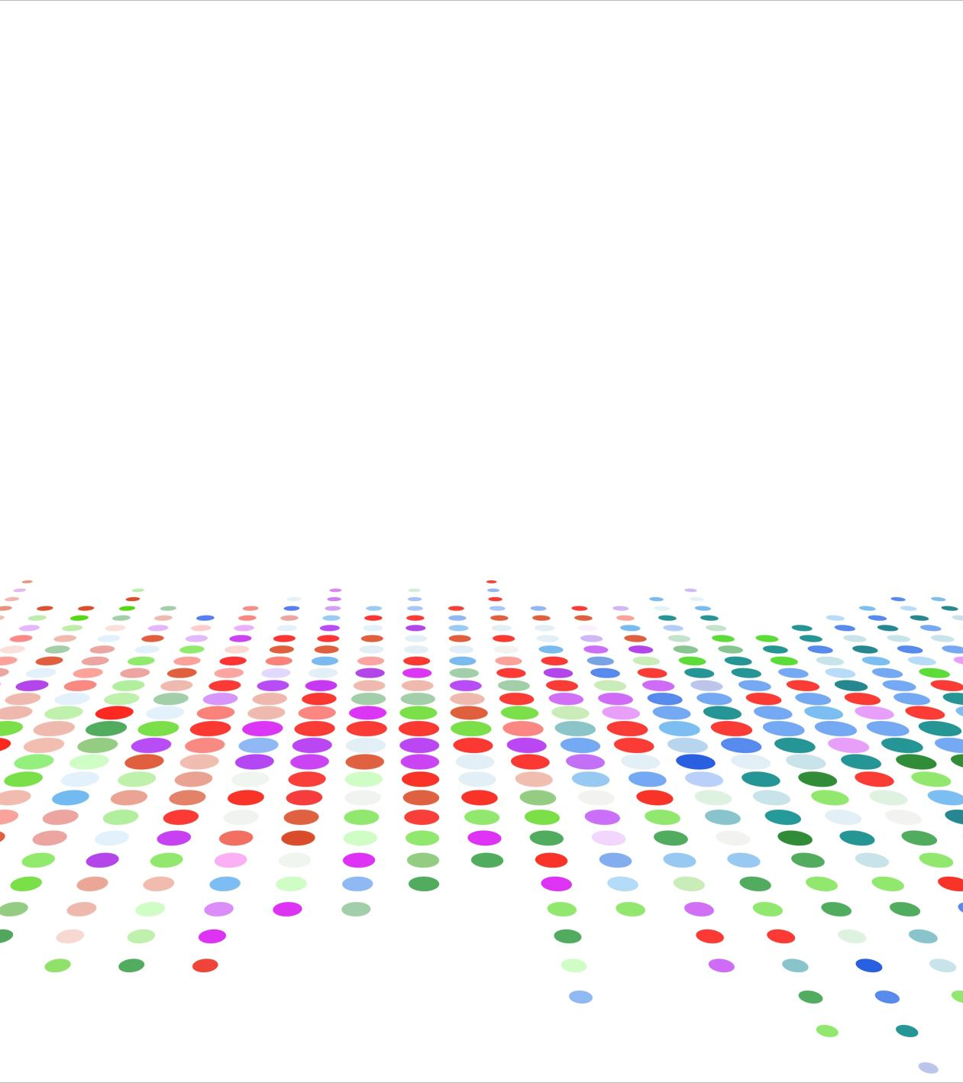
Scatter Plot
Jire Dada
CTEC298
Professor Bemley
4/16/2024

Slide 2
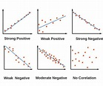
What is scatter plot
The type of graph that displayed the relationship between two variables. It shows the relationships and patterns in data that are represented on the graph.
This is a plot of X-axis AND Y-axis coordinates, presented in the plot on a graph as (x,y).

Slide 3
Types of scatter plots
The two types of scatter plots are two-dimensional (2D) and three-dimensional (3D). As the names indicate, a 2D scatter plot has coordinates on a two-dimensional graph with an x- and y-axis.
3D scatter plot uses a three-dimensional grid system incorporating a z-axis to show additional features like scale, product size, or price.

Slide 4
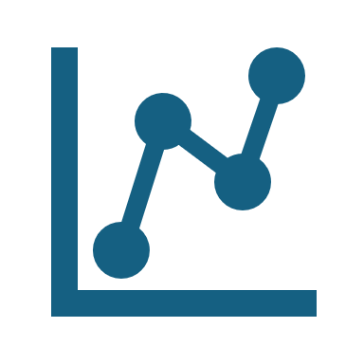
What is a scatter plot used for?
You may use a scatter plot to visualize the relationship between variables, especially when you're looking for trends and want to make predictions. For example, you may want to show a connection between sugar consumption and weight. You could plot this on a scatter plot, with one axis representing the amount of sugar each person consumed during a specific time. The other axis may represent the pounds gained or lost during that time.
Representing the data in this format helps you analyze it. You can see how the different data points relate to each other.

Slide 5
Scatter plots are more useful when you're working with paired numerical data and have no more than two variables to examine.
Examining the relationship between two variables. A human resources director may use a scatter plot to explore the connection between employees' salary and their sense of job satisfaction. After administering a job satisfaction survey, they could plot the survey results along with the salary of each participating employee and look for the connection between the two.

Slide 6

Who uses scatter plots?
People using data to draw conclusions and make predictions are likelier to use scatter plots. This includes those who work with numbers—economists, project managers, and scientists. If you are a data analyst, market analyst, or researcher, you may use scatter plots to identify trends and predict how people will behave.

Slide 7
Pros and cons of using scatter plots
Scatter plots, with their straightforward design, are a breeze to interpret. A mere glance can often reveal a correlation.
Scatter plots can show non-linear relationships. Some data may show up along a curved line or an irregular formation.
Scatter plots are easy to create. You can draw one by hand or create one using a computer program like Excel.
Scatter plots identify correlation. Knowing the relationship between the variables is a starting point for additional analysis.
Scatter plots allow for limited analysis. You can use a scatter plot to visualize two—and sometimes three-variables, therefore, you need another method for additional analysis.
Scatter plots do not indicate causation. Correlation is not the same as causation—two variables can be positively or negatively related and caused by additional variables that may not be indicated on the scatter plot.
Scatter plots with too many data points may be difficult to read. Overlapping data can dilute the data and slow the analysis process.

Slide 8
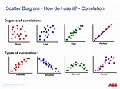
Data visualization of scatter plots
You can manually draw a scatter plot or create one in a program like Excel, Tableau, and Canva. How do you use a scatter plot? Drawing one by hand can help you understand how it works. To start, gather your data and record it in a two-column chart. If you want to create the scatter plot by hand, draw a graph and assign a variable to the x-axis and the y-axis. For each data set, place a dot on the spot where the two values intersect on the graph.

Slide 9
References
https://www.coursera.org/articles/what-is-a-scatter-plot
https://www.cuemath.com/data/scatter-plot/

